Slide 1
Support Vector Machine – SVM & Kernel Function
~ Pankaj

Slide 2
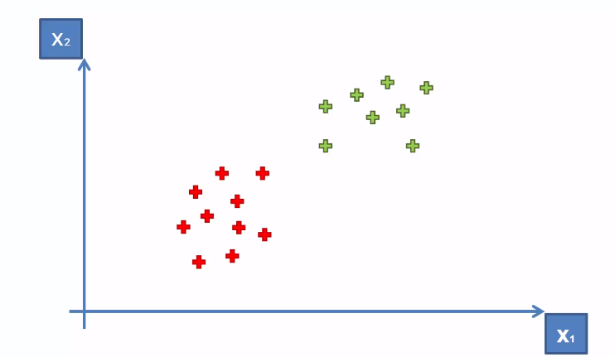
SVM – How to separate these points

Slide 3
SVM – How to separate these points

Slide 4
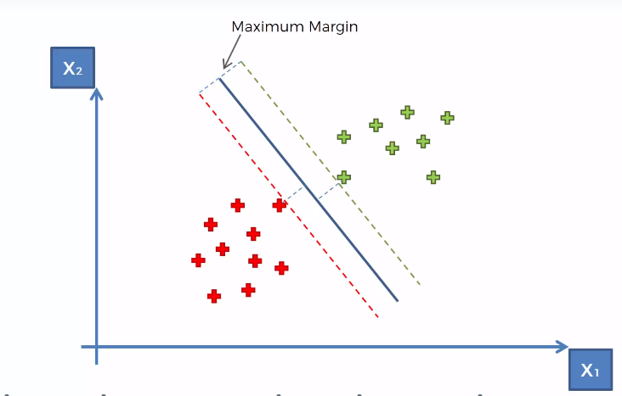
Support Vector Machine - Explanation

Slide 5
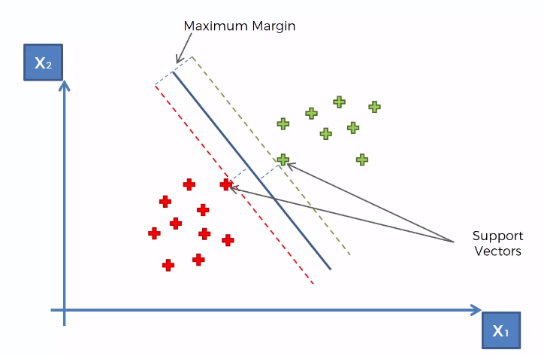
Support Vector Machine - Explanation

Slide 6
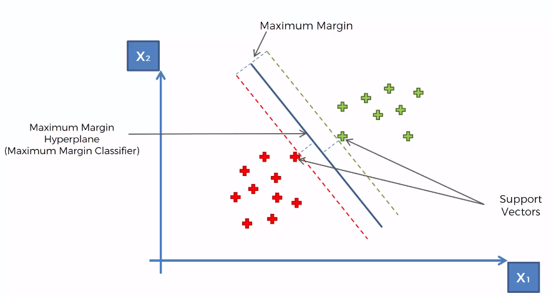
Support Vector Machine - Explanation

Slide 7
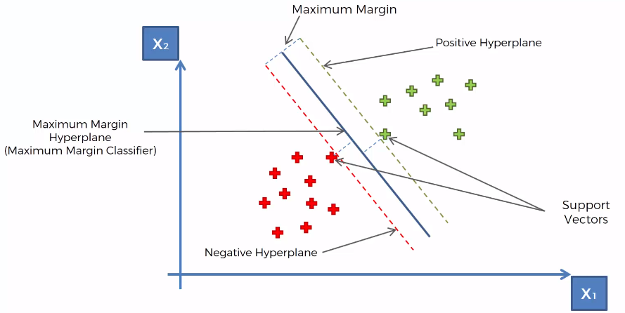
Support Vector Machine - Explanation

Slide 8
Support Vector Machine - Explanation
What’s so special about SVMs (Support Vector Machines) ?

Slide 9
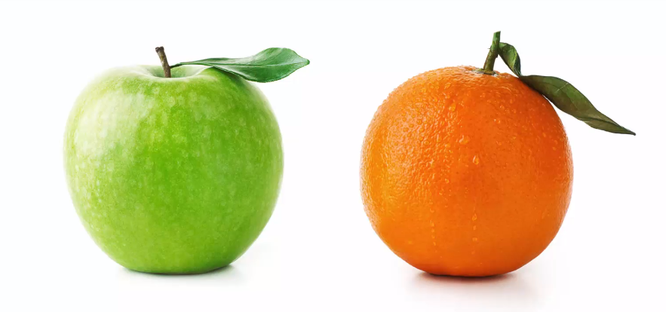
What’s so special about SVMs?
Suppose we want to machine to learn to classify an Apple and a Orange.

Slide 10
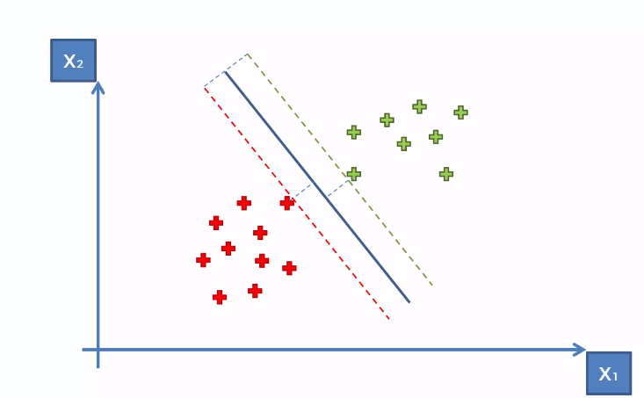
What’s so special about SVMs?

Slide 11
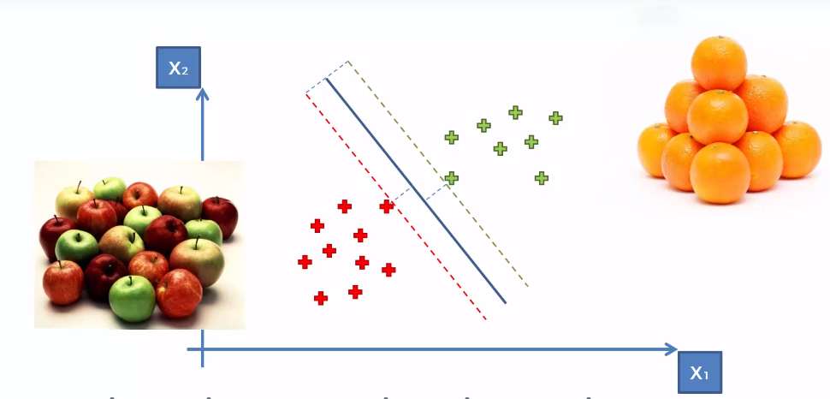
What’s so special about SVMs?

Slide 12
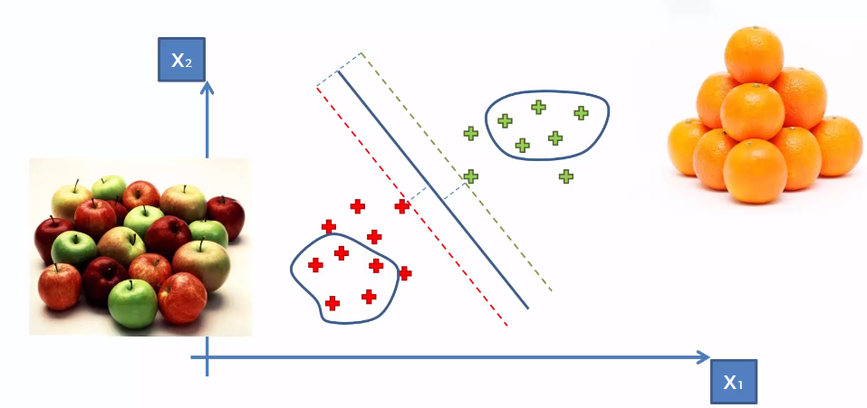
What’s so special about SVMs?
The general ML Algorithm tried to capture the properties of Apple and Orange and learn it as seen below:

Slide 13
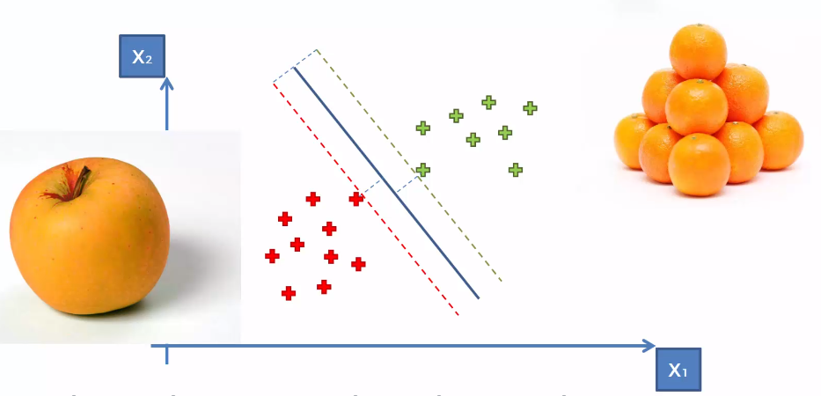
What’s so special about SVMs?
What SVM does it tries to find an Apple which looks like an Orange i.e. +ve/-ve Support Vectors.

Slide 14
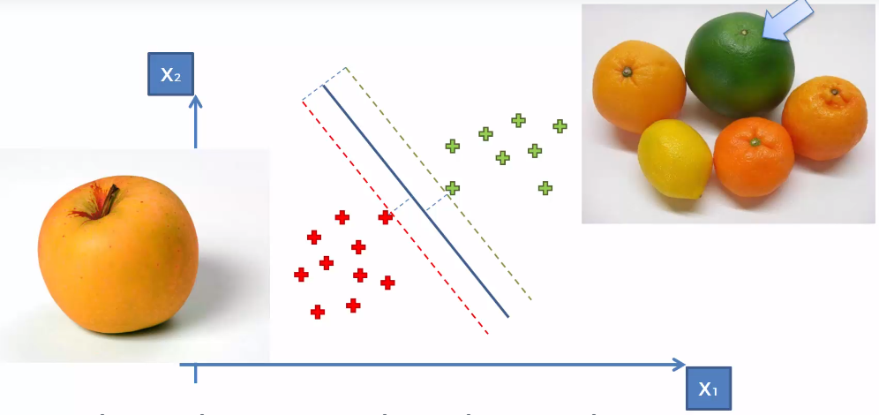
What’s so special about SVMs?
Similarly it tries to find an Orange which looks like an Apple i.e. +ve/-ve Support Vectors.

Slide 15
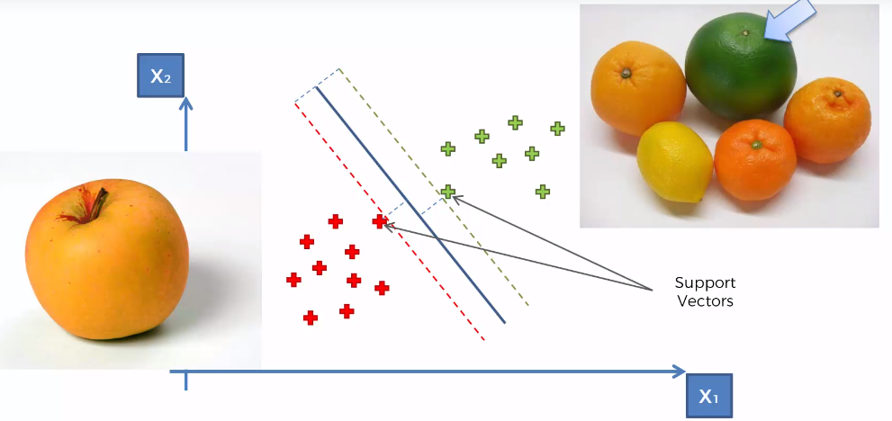
What’s so special about SVMs?

Slide 16
Kernel SVM
Kernel == Mathematical Equation

Slide 17
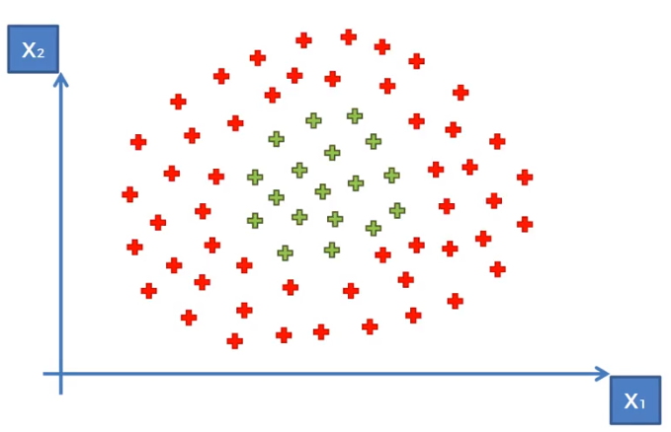
Kernel SVMs
How to classify if the points are scattered in below manner ?

Slide 18
Kernel SVMs
How to classify if the points are scattered in below manner ?
This happens when data is not
LINEARLY SEPERABLE

Slide 19
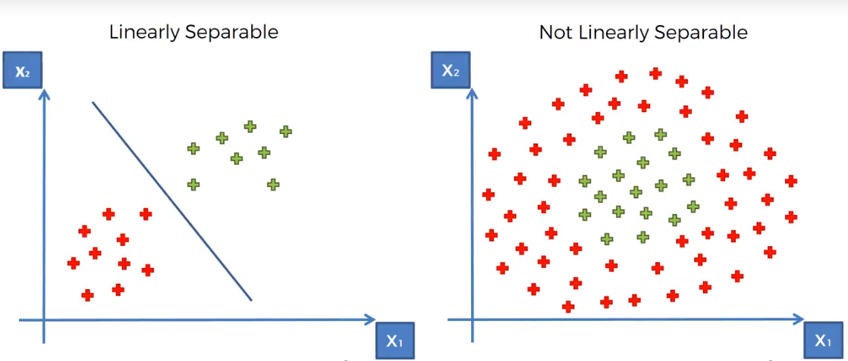
Kernel SVMs

Slide 20
Kernel SVMs
The non-linear data sets are separated by taking them to
A Higher-Dimensional Space
NOTE:
In 1 Dimension the linear separator is a DOT.
In 2 Dimension the linear separator is a LINE.
In 3 Dimension the linear separator is a Plane (HYPER PLANE).

Slide 21
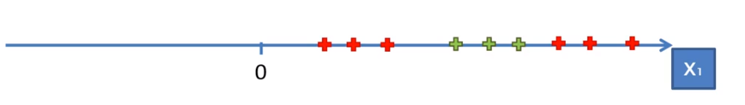
How to Map to Higher Dimension Space
Take a 1 dimensional data sets

Slide 22
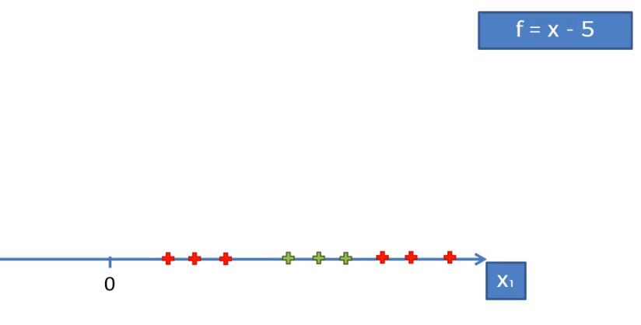
How to Map to Higher Dimension Space
Take a 1 dimensional data sets

Slide 23
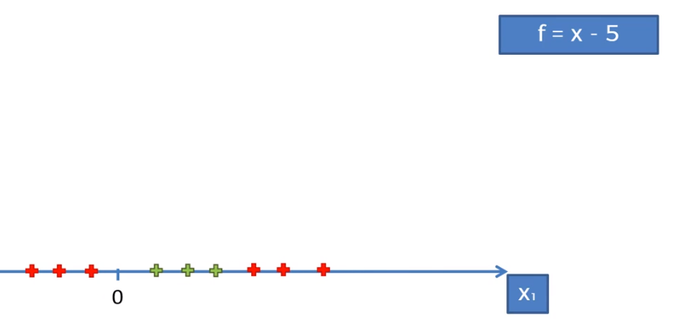
How to Map to Higher Dimension Space
Take a 1 dimensional data sets

Slide 24
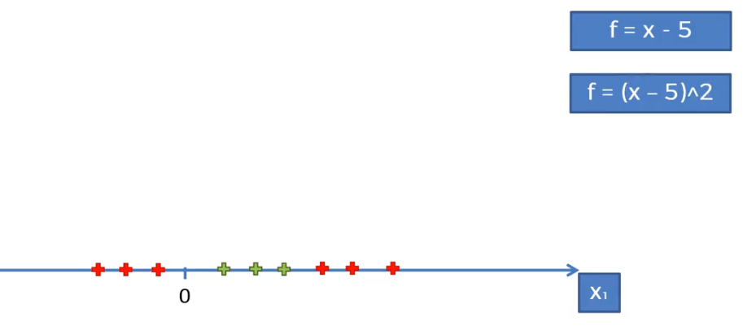
How to Map to Higher Dimension Space
Take a 1 dimensional data sets

Slide 25
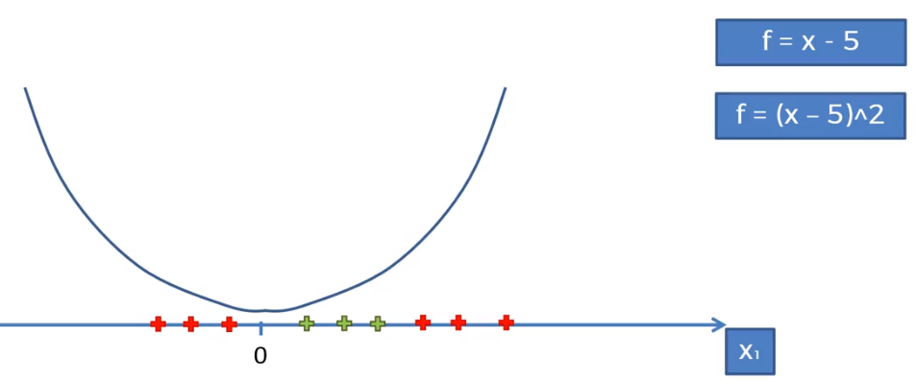
How to Map to Higher Dimension Space
Take a 1 dimensional data sets

Slide 26
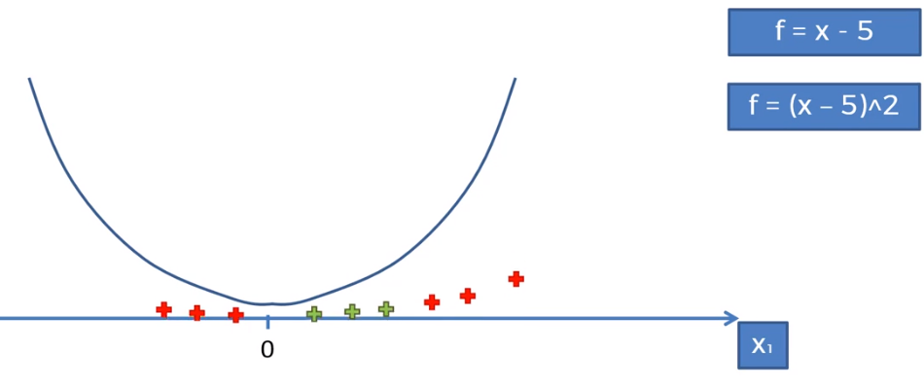
How to Map to Higher Dimension Space
Take a 1 dimensional data sets

Slide 27
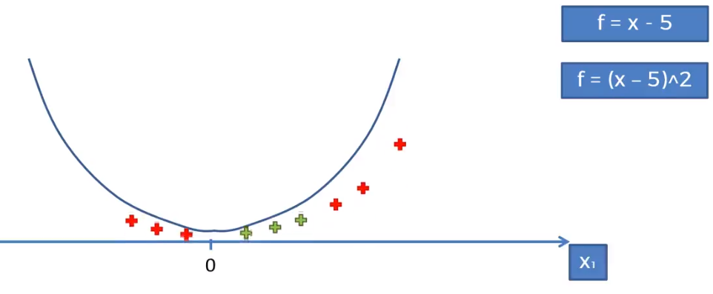
How to Map to Higher Dimension Space
Take a 1 dimensional data sets

Slide 28
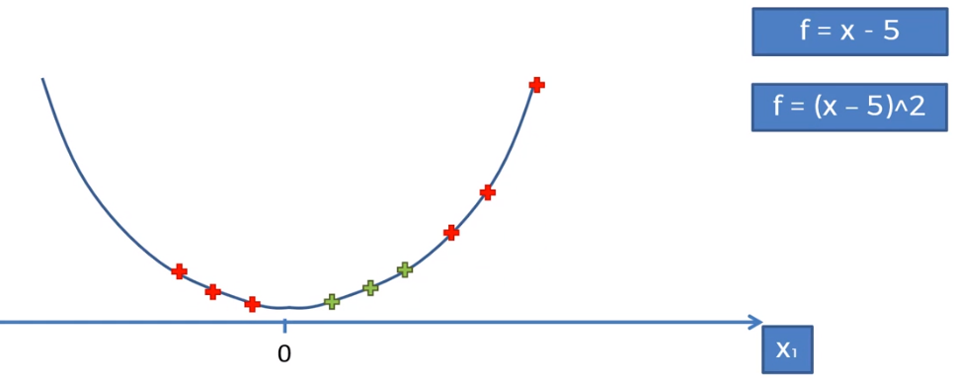
How to Map to Higher Dimension Space
Take a 1 dimensional data sets

Slide 29
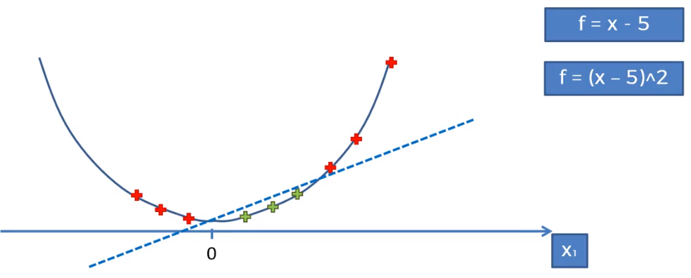
How to Map to Higher Dimension Space
Take a 1 dimensional data sets
Now, the line can be drawn from the point and the data is linearly seperable

Slide 30
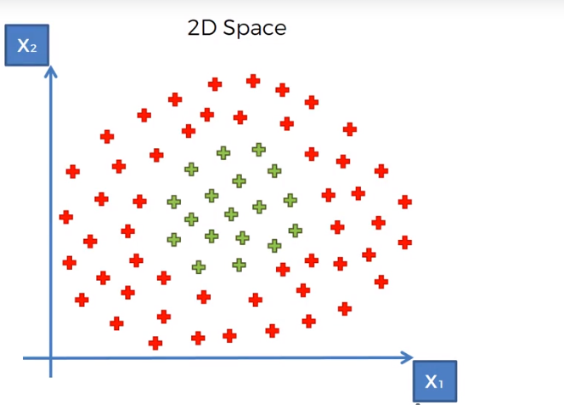
How to Map to Higher Dimension Space

Slide 31
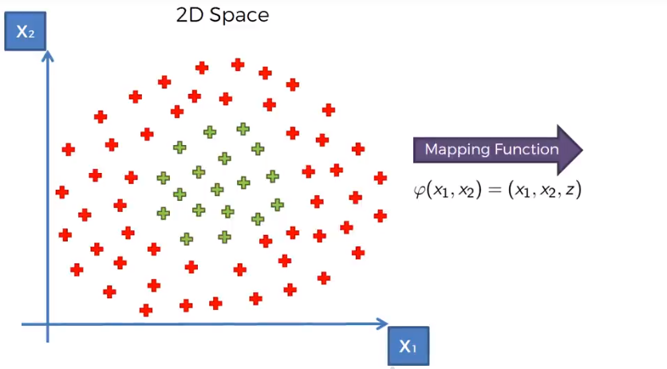
How to Map to Higher Dimension Space

Slide 32
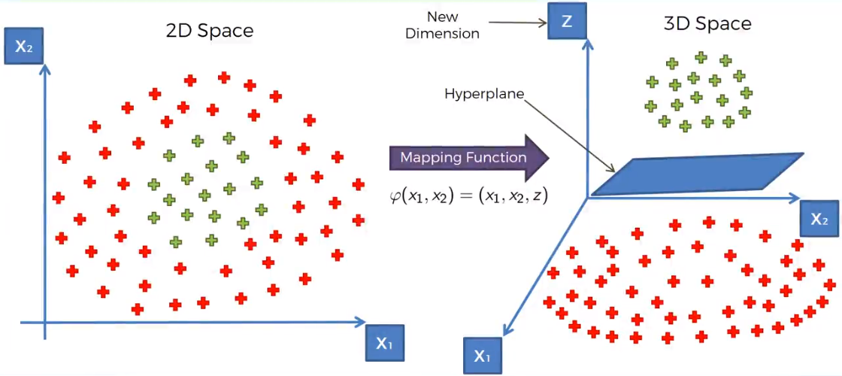
Mapping from 2D Space to Higher Dimension Space (3D)

Slide 33
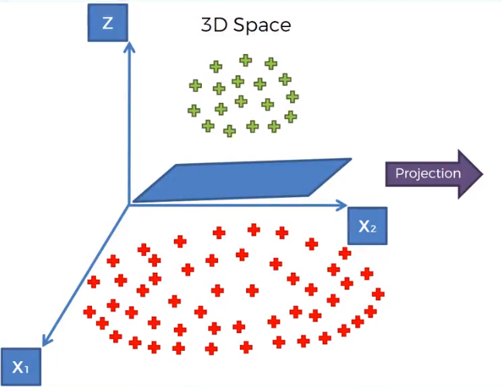
Projecting back to 2D Space

Slide 34
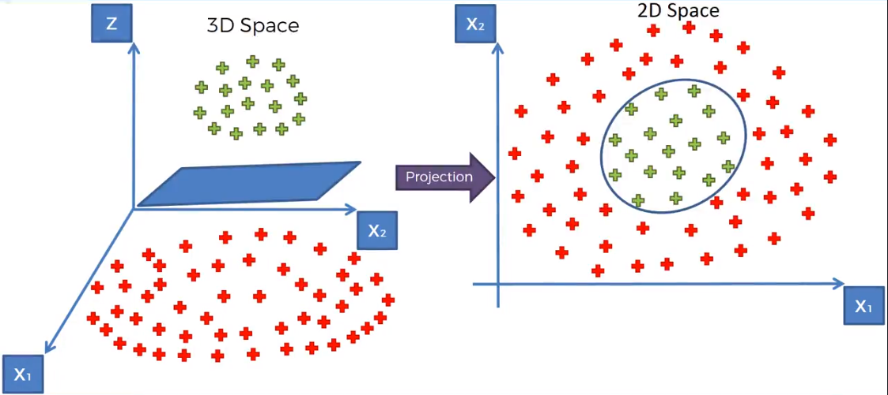
Projecting back to 2D Space

Slide 35
Problem with this approach is ….
Mapping to a Higher Dimensional Space can be
highly compute-intensive
Solution ….
By using the Kernel Trick

Slide 36
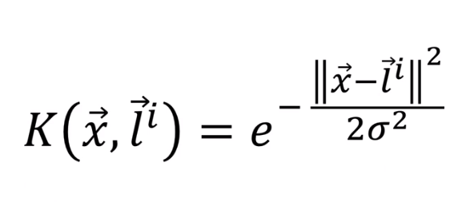
The Gaussian RBF Kernel
Distance between point and landmark and it’s square
Some Point in our dataset
landmark
Several landmark

Slide 37
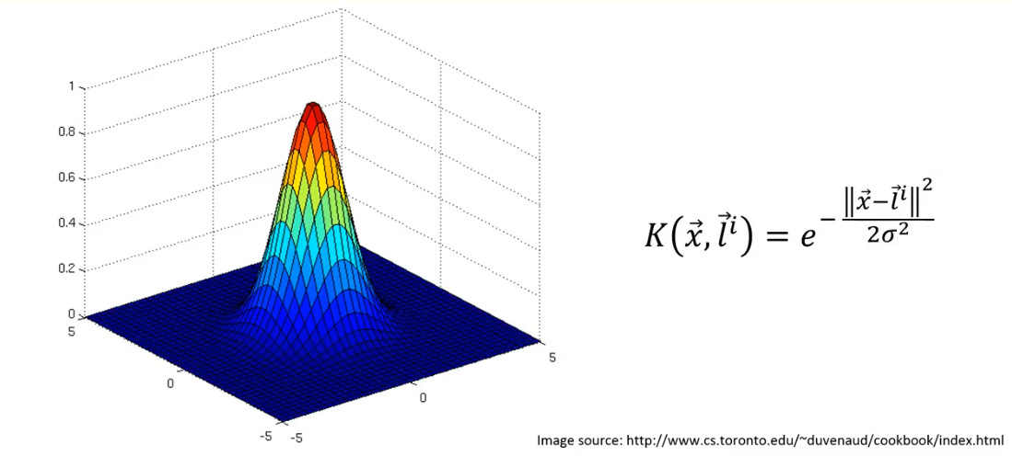
The Gaussian RBF Kernel
The figure below is the representation of function for a certain landmark given a point
The landmark is in the middle of the 3 dimensional space

Slide 38
The Gaussian RBF Kernel
The point on z-axis is the calculation of RBF Kernel for a given point and landmark.

Slide 39
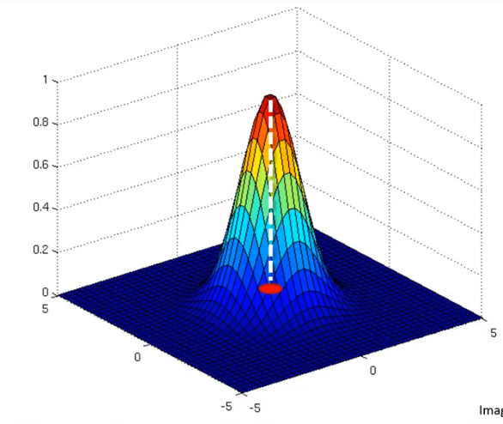
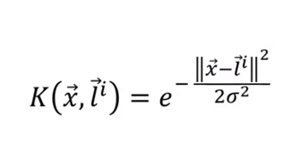
The Gaussian RBF Kernel
Landmark

Slide 40
The Gaussian RBF Kernel
Point = x
The point farther away from landmark is always close to zero on Z-axis

Slide 41
The Gaussian RBF Kernel
Point = x
The point closer to landmark is always gets closer to 1 on Z-axis

Slide 42
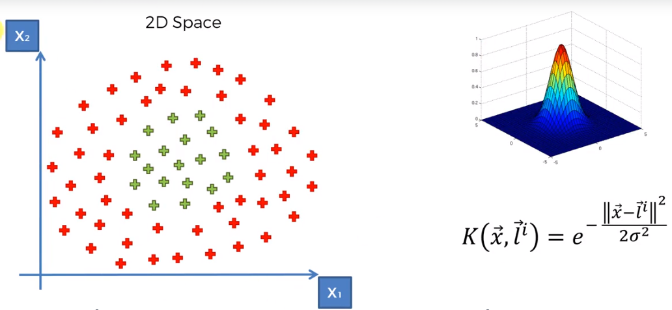
The Gaussian RBF Kernel

Slide 43
The Gaussian RBF Kernel
Landmark

Slide 44
The Gaussian RBF Kernel

Slide 45
The Gaussian RBF Kernel

Slide 46
The Gaussian RBF Kernel

Slide 47
The Gaussian RBF Kernel

Slide 48

The Gaussian RBF Kernel

Slide 49
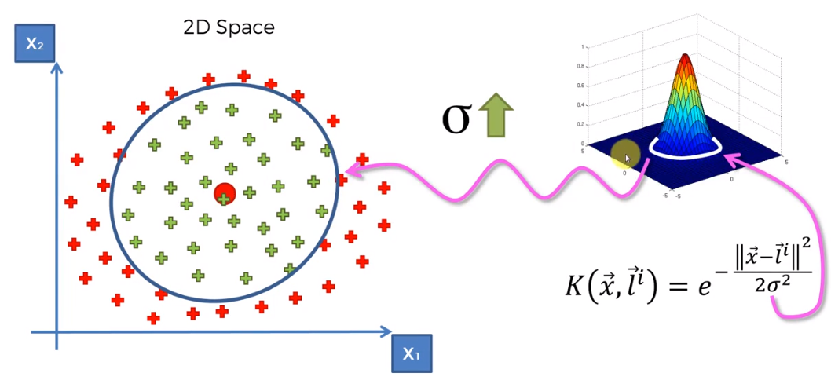
The Gaussian RBF Kernel

Slide 50
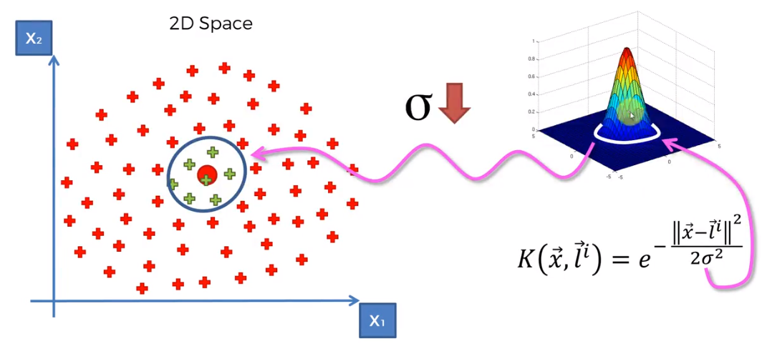
The Gaussian RBF Kernel

Slide 51
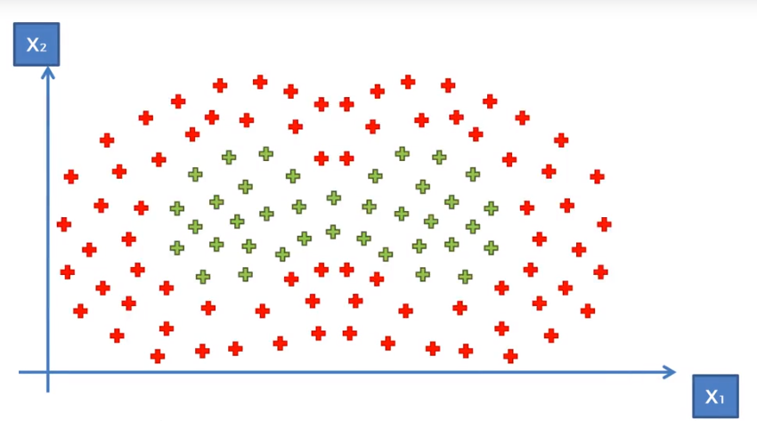
The Gaussian RBF Kernel

Slide 52
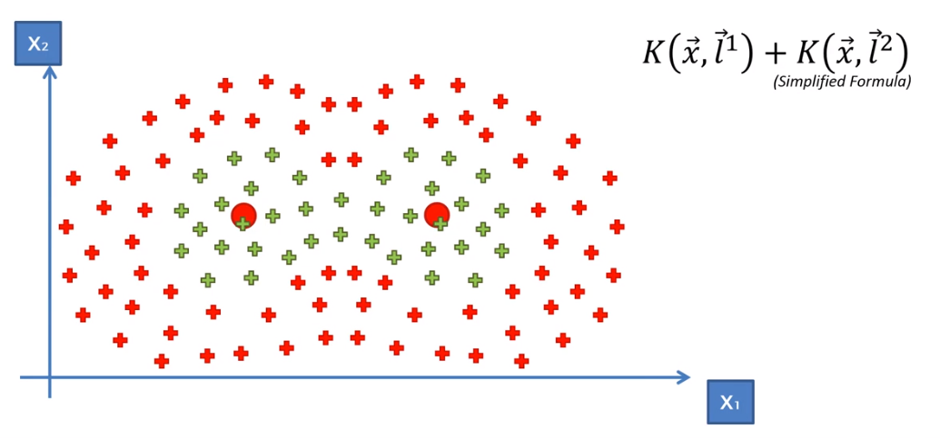
The Gaussian RBF Kernel

Slide 53
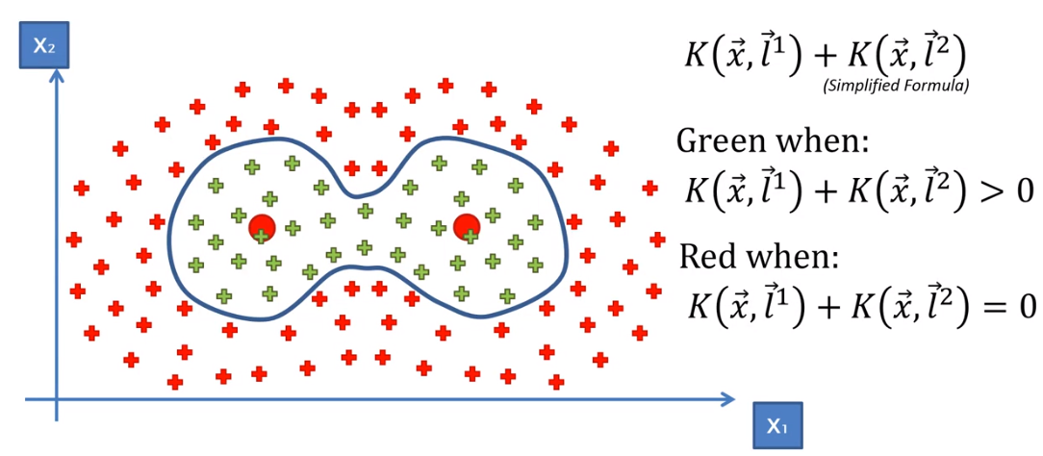
The Gaussian RBF Kernel

Slide 54
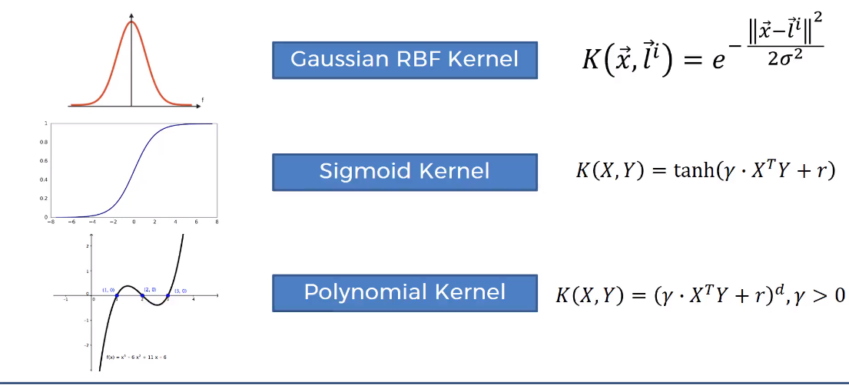
Types of Kernel Function

Slide 55
Types of Kernel Function
https://trthatcher.github.io/MLKernels.jl/dev/kernels/

